Slide 1
Introduction to Containers
Docker and Kubernetes
NA Partner Channels- IBM Cloud
IBM Cloud Technical Evangelist Team
January 24, 2018
© Copyright IBM Corporation 2018

Slide 2



Erika Bratschun
Erica Reuter
David Solomon
Technical Evangelist
Technical Evangelist
Technical Evangelist
Cloud, Cognitive and Analytics
Cloud, Analytics, and Analytics
Cloud, Cognitive, and Analytics

Slide 3
1
Containers
2
Why Containers?
3
Docker Containers
4
5
7
Container Orchestration
Kubernetes
Conclusion
Kubernetes in the IBM Cloud
6

Slide 4
Why Containers?

Slide 5
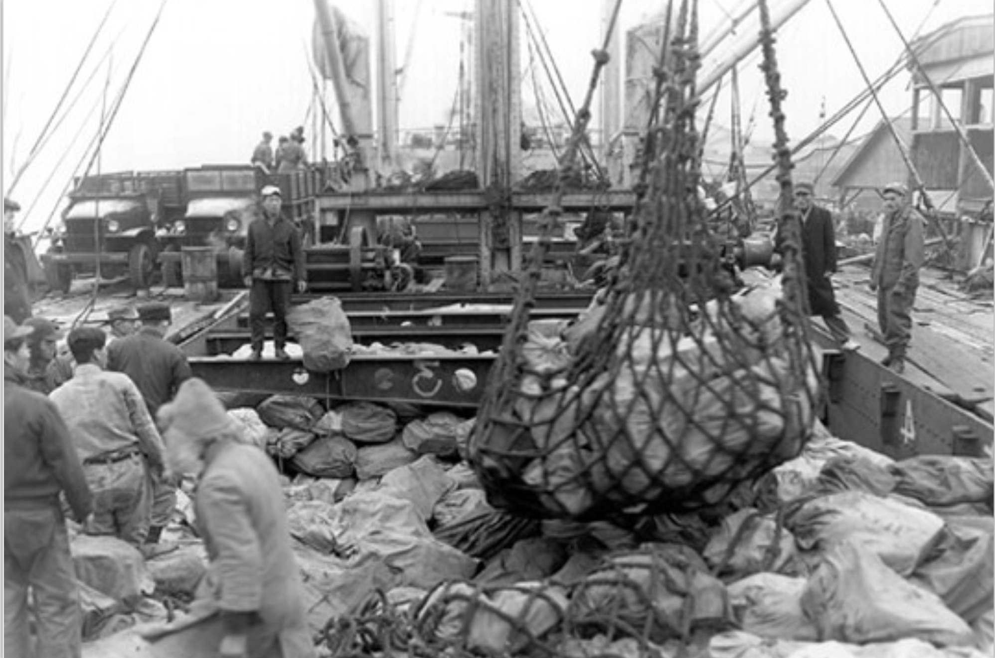
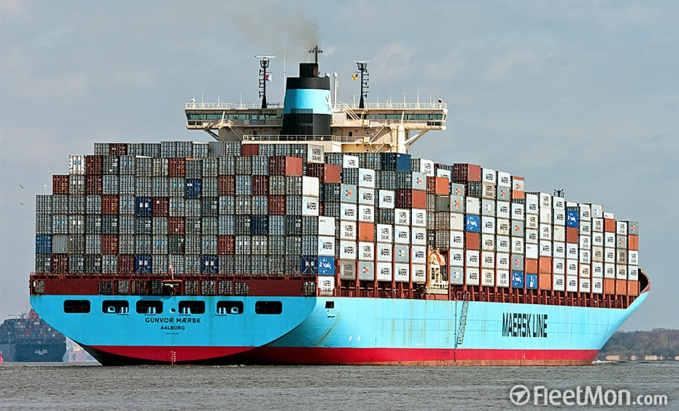
Everyone Loves Containers
A standard way to package an application and all its dependencies so that it can be moved between environments and run without changes
Containers work by isolating the differences between applications inside the container so that everything outside the container can be standardized
Notes:
Containers are a great way to organize things. Historically from a software perspective, however, things have not been as organized and bringing components together was a challenge.
Isolation is the key

Slide 6
Container History Lesson
1982
2000
2005
2006
2007
2008
Today
Unix/chroot
BSD
OpenVZ
Parallels
AIX Wpars
IBM
FreeBSD jails/Solaris zones
Cgroups/Process Containers
IBM/Google
Linux Containers (LXC)
Notes:
Verifying attempts at containerization over the years. The concepts is taking microservices + aspects of the application and put it in a black box and put an interface on it and call it a container.
Docker is most popular solution today. Cloud Foundry is out there as well but is more focused on infrastructure, and there are others as well.

Slide 7
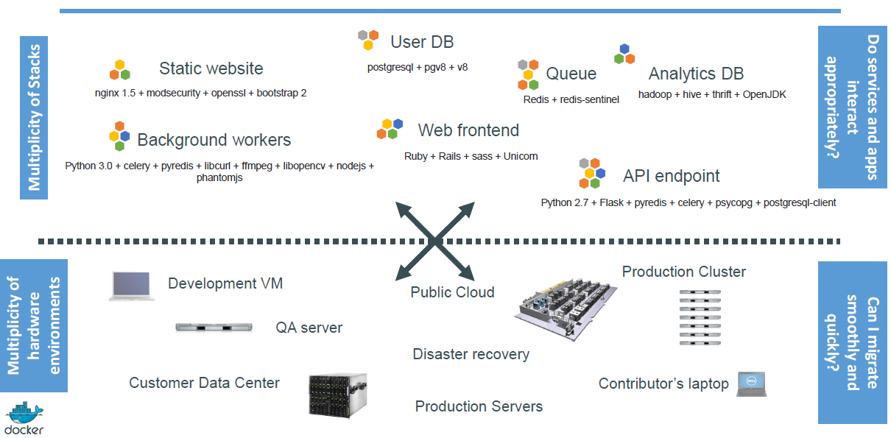
The Challenge
Notes:
Challenge is getting pieces to talk to each other. Dealing with different OS etc.

Slide 8
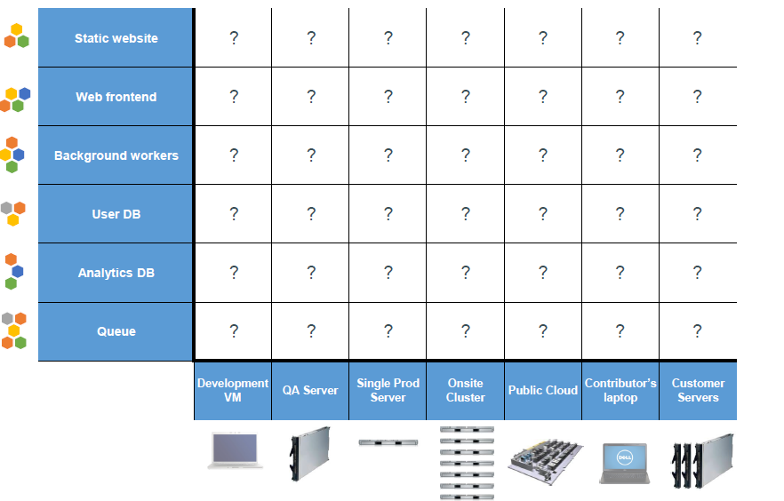
The Matrix from Hell
Notes:
The result is a a many-to-many matrix with different components each having to be concerned about the underlying infrastructure as well as many other varied components. This contributes to a brittle architecture that create a challenge when changes are made to the environment.

Slide 9
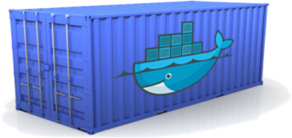

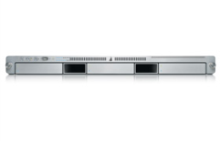
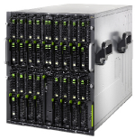
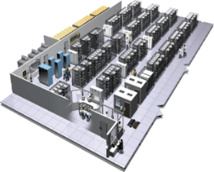
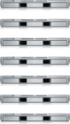

A Shipping Container for Code
Static website
User DB
Web frontend
Queue
Analytics DB
Do services and apps interact appropriately?
Multiplicity of Stacks
An engine that enables any payload to be encapsulated as a lightweight, portable, self-sufficient container…
…that can be manipulated using standard operations and run consistently on virtually any hardware platform
Multiplicity of hardware environments
Can I migrate smoothly and quickly
Development VM
Customer Data Center
Contributor’s laptop
QA server
Production Cluster
Public Cloud
Notes:
Container is more than just code like “hello world” but it’s everything hello world needs to run. Completely self contained environment for what the program needs to do.
Container can be deployed anywhere… on VM… on any OS. This reduces the dependence of the code on underlying infrastructure.
They can be strung together. They can be deployed with out changes to any platform supported.

Slide 10
VM’s vs. Containers
Containers are isolated, but share OS and, where
appropriate, bins/libraries
…faster, less overhead
_{App}
_{A}
_{App}
_{A’}
_{App}
_{B}
_{Bins/}
_{Libs}
_{Bins/}
_{Libs}
_{Bins/}
_{Libs}
_{VM}
_{Guest}
_{OS}
_{Guest}
_{OS}
_{Guest}
_{OS}
_{Guest}
_{OS}
_{Guest}
_{OS}
App A
App A’
App B
App B’
App B’
App B’
Docker Engine
Container
_{Hypervisor (Type 2)}
Bins/Libs
Bins/Libs
_{Host OS}
Host OS
_{Server}
Server
Notes:
VM very different from container
VM is full blown computer that lies on top of hardware. It brings baggage of hardware system with it, and are very large. Bring a lot of extra stuff to run single applications sometimes.
Containers are smaller and only brings what is needed to run the specific code in question, running on top of operating system.
Much less overhead and lower licensing costs of OS in VM etc. The Docker engine is the key to support.
Abstraction is the key to all software evolution

Slide 11
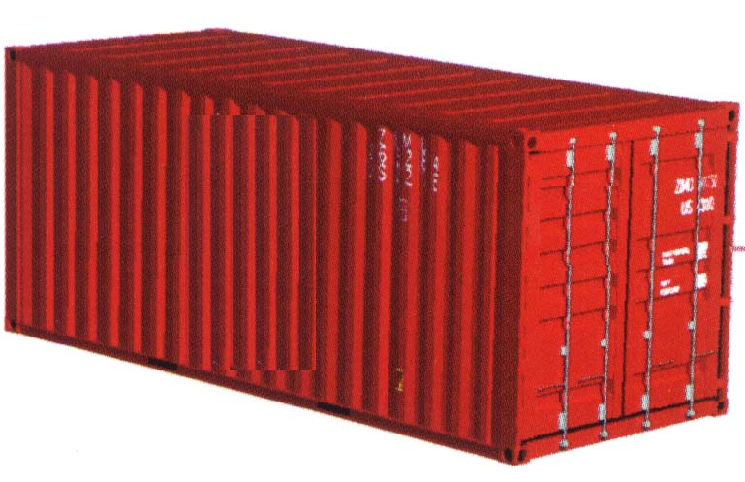
Dev vs. Ops
Dev | Ops
Code Libraries Configuration Server runtime OS | Logging Remote access Network configuration Monitoring
Separation of concerns
A container separates and bridges the Dev and Ops in DevOps
Dev focuses on the application environment
Ops focuses on the deployment environment
Notes:
2 responsibilities in orgs that are typically at odds: one cares more about reliability in production, the other cares about building great software. Containers helps with this issue as the latest version of the container can be put into production rather than the individual underpinnings of the solution.
Dev side – gives advantage of not worrying about underlying infrastructure. Reduces odds of issues coming up in production.

Slide 12
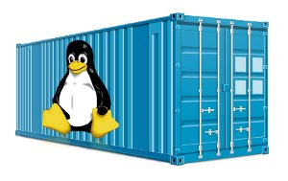
Container Advantages
Containers are portable
Containers are easy to manage
Containers provide “just enough” isolation
Containers use hardware more efficiently
Containers are immutable
Notes:
Containers are portable
Any platform with a container engine can run containers
Containers are easy to manage
Container images are easy to share, download, and delete
Especially with Docker registries - The Registry is a stateless, highly scalable server side application that stores and lets you distribute Docker images. The Registry is open-source, under the permissive apache license
Container instances are easy to create and delete
Each container instance is easy and fast to start and stop
Containers provide “just enough” isolation
More lightweight than virtual machines
Processes share the operating system kernel but are segregated
Containers use hardware more efficiently
Greater density than virtual machines
Especially Docker containers, which can share layers - layers are worth understanding once we get the basics out of the way. There are good notes in the docs.docker.com
Containers are immutable
Container images are versions
Containers cannot (should not) be patched

Slide 13
Docker Containers

Slide 14
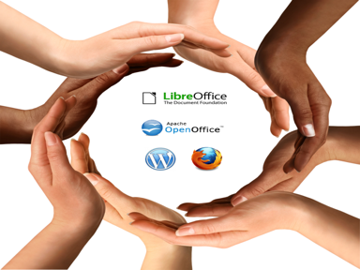
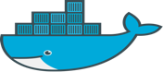
Docker Adoption
Docker enables application development efficiency, making deployment more efficient, eliminating vendor ‘lock-in’ with true portability
Open software
Open contribution
Open design
Open governance
Notes:
Open software
Launched March 2013
2.0+ billion downloads of Docker images
Open contribution
2000+ contributors
#2 most popular project
185 community meet-up groups in 58 countries
Open design
Contributors include IBM, Red Hat, Google, Microsoft, VMware, AWS, Rackspace, and others
Open governance
12 member governance advisory board selected by the community

Slide 15
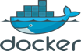
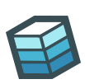
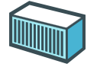
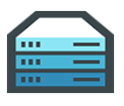



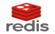


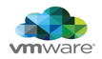
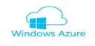
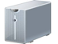
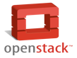




Docker Mission
Docker is an open platform for building distributed applications for developers and system administrators
Build
Ship
Run
Any App
Anywhere
Notes:
Build Ship and Run discussed by Docker anywhere. That’s the lifecycle. - Main tenants.

Slide 16



Docker Components
Image
A read-only snapshot of a container stored in Docker Hub to be used as a template for building containers
Container
The standard unit in which the application service resides or transported
Docker Hub/Registry
Available in SaaS or Enterprise to deploy anywhere you choose
Stores, distributes, and shares container images
Docker Engine
A program that creates, ships, and runs application containers
Runs on any physical and virtual machine or server locally, in private or public cloud
Client communicates with Engine to execute commands
SaaS
Enterprise
Notes:
Image: What you deploy or what you put in runtime. When you put an app in docker that creates an image. This is the physical version of a container that sits on a hard drive until you instantiate
The container: The same image in runtime.
The registry: This is how the containers get distributed to other people. There is one in docker called dockerhub (public open marketplace for container).
Docker Engine: App that sits on hardware to run the containers and manage the process.

Slide 17

Containers
Everyone’s container journey starts with one container….

Slide 18
Containers
At first the growth is easy to handle….

Slide 19
Containers
But soon it is overwhelming… chaos reigns
Notes:
Eventually you need a system to manage the containers and this is where orchestration comes in

Slide 20
Orchestration

Slide 21
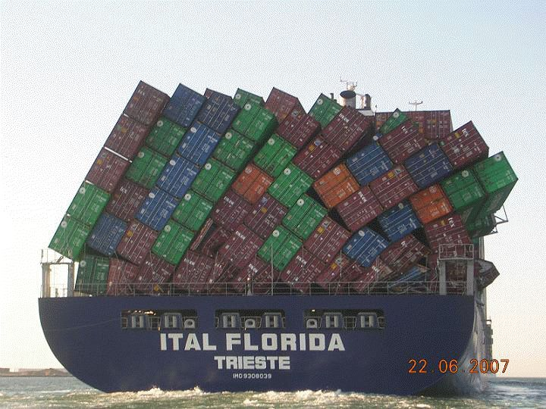


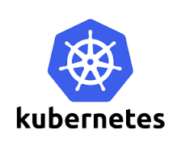



More to Containers than just Docker
Serverless
PaaS
Container Orchestration
Swarm/
Swarm Mode
Container Engine
Notes:
Docker world contains more than just Docker. Other pieces are required to make it work including orchestration.
Kuberenetes is king of orchestration at the moment.

Slide 22
What is Container Orchestration?
Container orchestration
Cluster management
Scheduling
Service discovery
Replication
Health management
Container Orchestrator
Manager
Image Repository
Scheduler
Discovery DB
Replicator
Node
Node
Node
Daemon
Daemon
Daemon
Containers
Containers
Containers
Notes:
Container orchestration
Manages the deployment, placement, and lifecycle of workload containers
Cluster management
Federates multiple hosts into one target
Scheduling
Distributes containers across nodes
Service discovery
Knows where the containers are located
Distributes client requests across the containers
Replication
Ensures the right number of nodes and containers
Health management
Replaces unhealthy containers and nodes

Slide 23


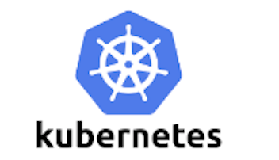


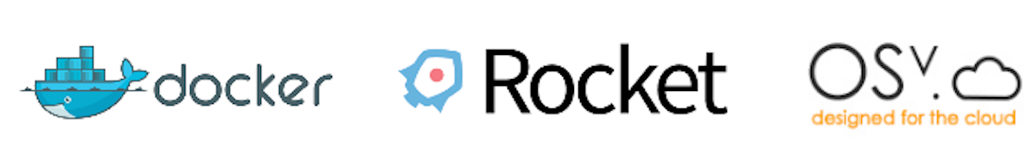

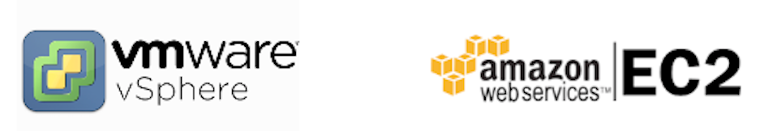
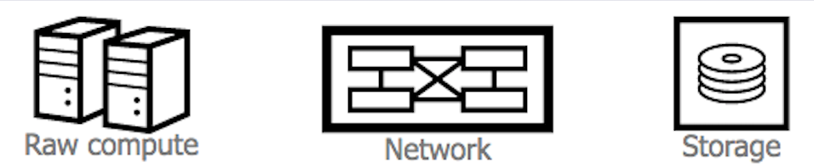
Container Ecosystem Layers
Layer 6
Development Workflow
Opinionated Containers
Layer 5
Orchestration/Scheduling
Service Model
Layer 4
Container Engine
Layer 3
Operating System
Layer 2
Virtual Infrastructure
Layer 1
Physical Infrastructure

Slide 24
Kubernetes

Slide 25

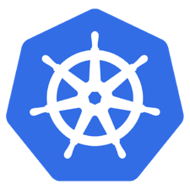


What is Kubernetes?
Container orchestrator
Manage applications, not machines
Designed for extensibility
Open source project managed by the Linux Foundation
Notes:
Container orchestrator
Runs and manages containers
Unified API for deploying web applications, batch jobs, and databases
Maintains and tracks the global view of the cluster
Supports multiple cloud and bare-metal environments
Manage applications, not machines
Rolling updates, canary deploys, and blue-green deployments
Designed for extensibility
Rich ecosystem of plug-ins for scheduling, storage, networking
Open source project managed by the Linux Foundation
Inspired and informed by Google's experiences and internal systems
100% open source, written in Go

Slide 26
Kubernetes Architecture
UI
Kubernetes Master
Worker Node 1
Worker Node 2
API
Worker Node 3
CLI
Worker Node n
Registry
Etcd
API Server
Controller Manager Server
Scheduler
Notes:
Different ways to talk to Kubernetes. UI or CLI to master node. Various things run in master node like scheduler, key value database to contain info about cluster, and controller. Kubernetes is a cluster for running containers. It speaks to registry to run containers on request.
Etcd is data storage for cluster. It’s an open source key value data store.

Slide 27
Kubernetes Architecture: Workloads
Kubernetes components
Container
Packaging of an app
Pod
Unit of deployment
Service
Fixed endpoint for 1+ pods
Master Node
Worker Node 1
Pod
Pod
App A
App B
App A Client
App A Service
Worker Node 2
Pod
Pod
App B
App A
App B Client
App B Service
Worker Node 3
Pod
Pod
App A
App B
Notes:
What actually happens when you’re running this:
3 major things to think about:
1 – The container or the app you are running.
2 – Pod. When you deploy you’re not actually deploying the container, but rather the pod that isolates and organizes the containers. Highly related containers may sit in same pod. Nice thing about pods is multiple instances can be running.
3 – Service or how you talk to Pod for outside world. Exposes pod to outside world. Some pods are internal only and will not have a service to expose it. Example is login service… needs that service to expose the pod to the outside world via the configured port etc.
Application A is being called by a lot of things… it’s getting too many calls. So you can use Pods to load balance across the cluster. Alternative is to have 2nd pod running as hot standby in case something happens.
Kubernetes has reserved address space. Will auto pick one for you in config. Can run command to get a list for all or one

Slide 28
Kubernetes Terminology: Deployment
Deployment
A set of pods to be deployed together, such as an application
Declarative: Revising a Deployment creates a ReplicaSet describing the desired state
Rollout: Deployment controller changes the actual state to the desired state at a controlled rate
Rollback: Each Deployment revision can be rolled back
Scale and auto scale: A Deployment can be scaled
ReplicaSet
The next-generation Replication Controller
A set of pod templates that describe a set of pod replicas
Uses a template that describes specifically what each pod should contain
Ensures that a specified number of pod replicas are running at any given time
Deployment
create
ReplicaSet 1
Deployment
rollback
rollout
ReplicaSet 1
ReplicaSet 2
rolling update
pod
pod
pod
ReplicaSet 2
svcA
svcA
svcB
Notes:
When you put something in runtime in kubernetes you’re putting it into deployment. Can do by:
Telling it what image to use
Replica sets created with deployment by default: allows for multiple images of pods. Can change how set is created in config. Can do things like set pod to persevere so rollbacks are possible.

Slide 29
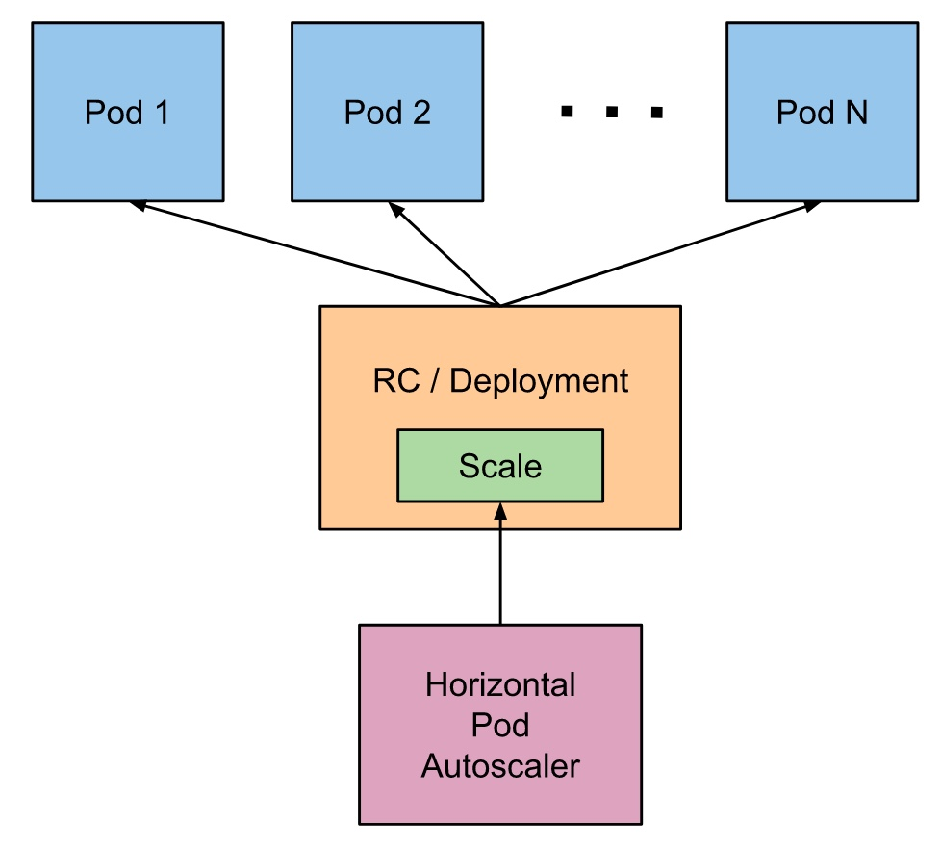
Kubernetes Terminology: Autoscaling
Horizontal Pod Autoscaling (HPA)
$ kubectl autoscale deployment <deployment-name> --cpu-percent=50 --min=1 --max=10 deployment ”<hpa-name>" autoscaled
Notes:
Horizontal Pod Autoscaling (HPA)
Automatically scales the number of pods in a replication controller, deployment, or replica set
Matches the observed average CPU utilization to the specified target
Fetches metrics in two different ways: direct Heapster access and REST client access
Kubernetes Heapster enables container cluster monitoring and performance analysis
Default config: query every 30 sec, maintain 10% tolerance, wait 3 min after scale-up, wait 5 min after scale-down
$ kubectl autoscale deployment <deployment-name> --cpu-percent=50 --min=1 --max=10 deployment ”<hpa-name>" autoscaled
Creates a horizontal pod autoscaler
An HPA instance
Maintains between 1 and 10 replicas of the pods controlled by the deployment
Maintains an average CPU utilization across all pods of 50%

Slide 30
Common Kubernetes Commands
Get the state of your cluster
$ kubectl cluster-info
Get all the nodes of your cluster
$ kubectl get nodes -o wide
Get info about the pods of your cluster
$ kubectl get pods -o wide
Get info about the replication controllers of your cluster
$ kubectl get rc -o wide
Get info about the services of your cluster
$ kubectl get services
Get full config info about a Service
$ kubectl get service NAME_OF_SERVICE -o json
Get the IP of a Pod
$ kubectl get pod NAME_OF_POD -template={{.status.podIP}}
Delete a Pod
$ kubectl delete pod NAME
Delete a Service
$ kubectl delete service NAME_OF_SERVICE
Notes:
The primary command people use is kubectl. Almost everything you do is derived from that command. Here are some examples of others.
The minikube env for the lab runs the same way. There is a slight variation fro how to run the dashboard. Other than that it’s the same.

Slide 31

Helm & Helm Chart
Helm
Package manager for Kubernetes
Used to manage Kubernetes applications
Helm Chart
Used to define, install, and upgrade complex Kubernetes applications
Easy to create, version, share and publish
Expressed in “Yet Another Markup Language” (YAML) files
Notes:
Helm chart takes complex application and has predefined way to deploy. Think of it as a template.
Ex – we have a helm chart for DSX local. Click install using chart and it will find all the needed pieces and do the install perfectly. Makes migration and deployment easy.

Slide 32
Kubernetes in the IBM Cloud

Slide 33
Kubernetes in the IBM Cloud
Leveraging kubernetes in ibm cloud public and private
Combine the power of open source with the scale of the IBM Cloud
Accelerate Innovation and improve time-to-market by empowering developers to rapidly build cloud-native and cloud compatible applications for both new and existing workloads
Integrate cloud and on-prem applications to a host of enterprise-scale capabilities and services with the applications you are developing such as analytics, Machine Learning, AI (Watson), middleware, and IoT services.
Leverage operational services to help you manage your environment, including monitoring, log management, and security
Notes:
Kubernetes is available in both IBM Cloud and IBM Cloud Private. Both environments provide the ability to easily deploy your applications and leverage additional Enterprise-scale services from the IBM Cloud such as analytics, security, Watson, and middleware

Slide 34
Kubernetes in the IBM Cloud
Two Primary options
IBM Cloud (Public)
IBM Kubernetes Container Service available as a fully managed service, as well as private Docker registry
Pods and Containers can leverage other IBM Cloud services, such as Watson AI, the Watson Data Platform, and many others
Pods and Containers can access your services either on-prem or from other cloud providers through secure means
Full DevOps services available to help manage application development
IBM Cloud Private
An operational Kubernetes-focused development and production version of IBM Cloud for deployment in your on-prem or cloud environment
Enterprise-quality management, scalability, security, and resiliency features to support your Kubernetes Cluster deployment
Built-in access to enterprise services such as analytics, middleware, data storage, and data science
Access and integrate to your other on-prem and/or cloud services

Slide 35
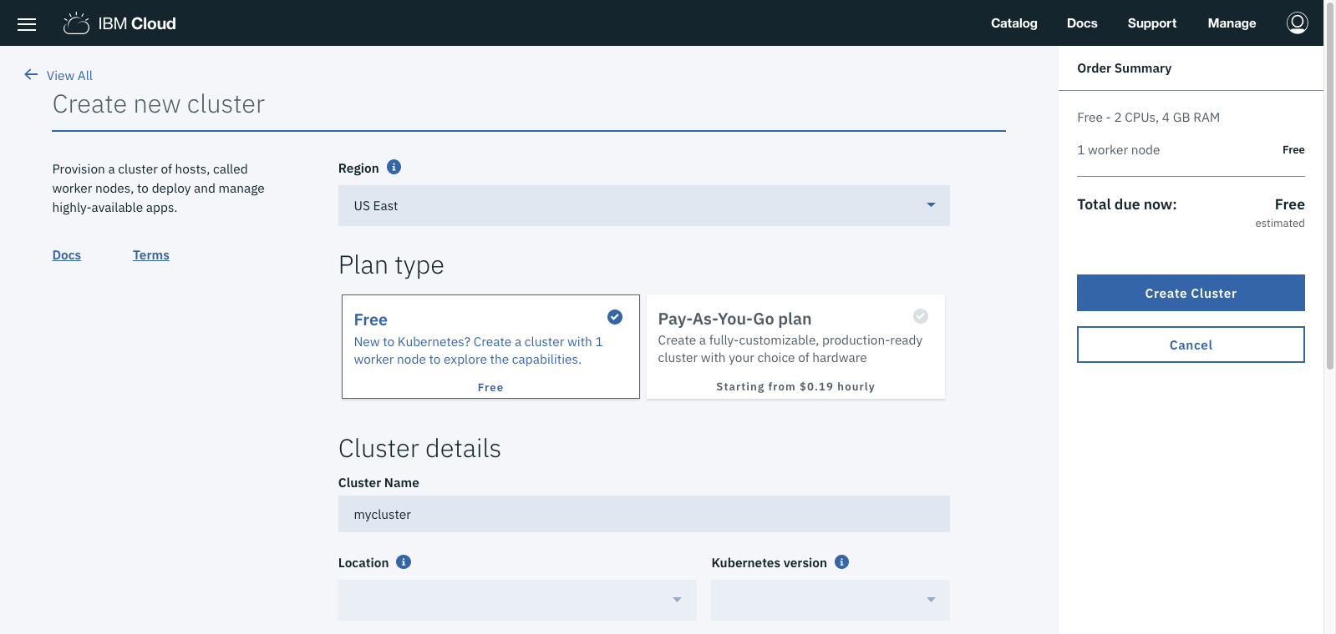
IBM Cloud Kubernetes Options

Slide 36
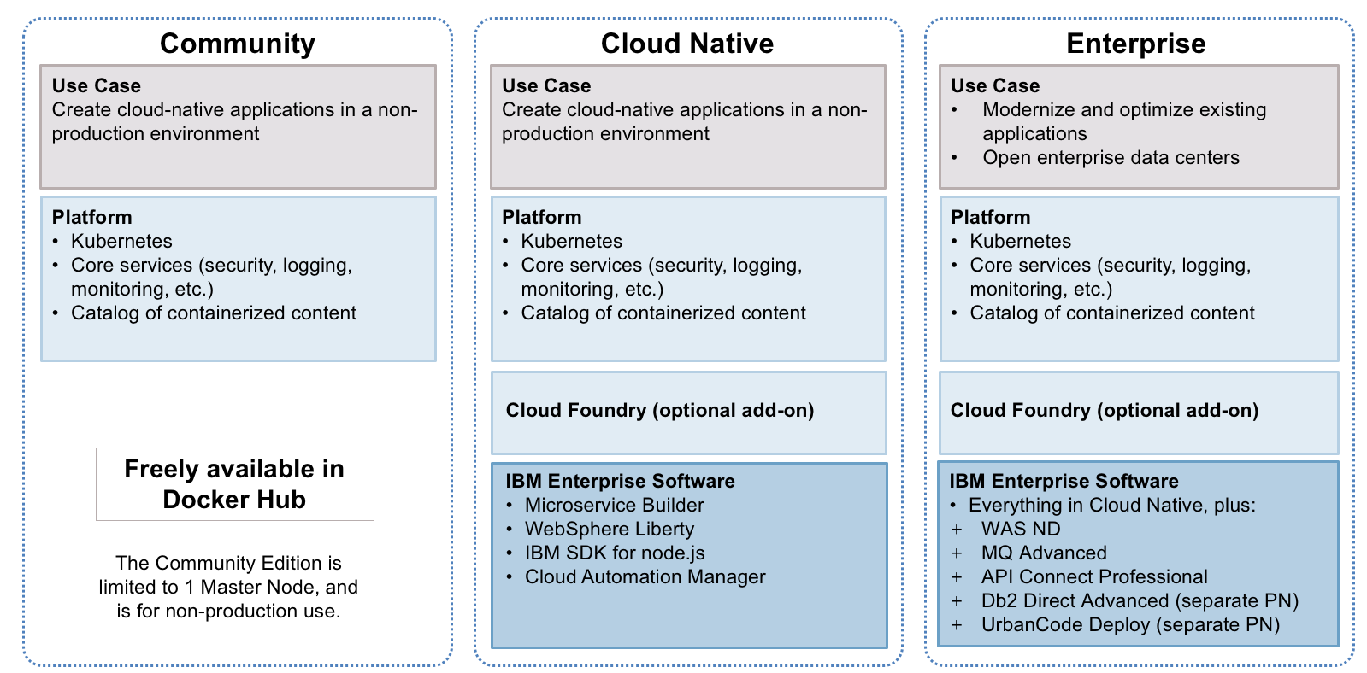
IBM Cloud Private Options

Slide 37
Conclusion

Slide 38
Conclusion
Why containers?
Docker containers
Container orchestration
Kubernetes
Kubernetes in the IBM Cloud

Slide 39
Resources
Docker tutorial
https://docs.docker.com/get-started/
Kubernetes tutorial
https://kubernetes.io/docs/tutorials/kubernetes-basics/
The Evolution of Linux Containers and Their Future
https://dzone.com/articles/evolution-of-linux-containers-future
Introduction to container orchestration
https://www.exoscale.ch/syslog/2016/07/26/container-orch/
TNS Research: The Present State of Container Orchestration
https://thenewstack.io/tns-research-present-state-container-orchestration/
Large-scale cluster management at Google with Borg
https://research.google.com/pubs/pub43438.html

Slide 41
Docker Containers
Docker uses a copy-on-write (union) filesystem
New files (& edits) are only visible to current/above layers
CNTR1
CNTR2
CNTR3
CNTR4
Layer
app1
app2
app3
app4
Layer
tomcat
liberty
tomcat
Layer
Fedora
Ubuntu
Base OS / Kernel
Filesystem
Layers allow for reuse
More containers per host
Faster start-up/download time – base layers are "cached"
Images
Tarball of layers (each layer is a tarball)

Slide 42
Why Customers are Interested in Docker
Containers are a critical foundation for hybrid apps
Ship more software
Accelerate development and CI/CD pipelines by eliminating headaches of setting up environments and dealing with differences between environments
On average, Docker users ship software 7X more frequently
Resource efficiency
Lightweight containers run on a single machine and share the same OS kernel while images are layered file systems sharing common files to make efficient use of RAM and disk and start instantly
App portability
Isolated containers package the application, dependencies and configurations together
These containers can then seamlessly move across environments and infrastructures

Slide 43
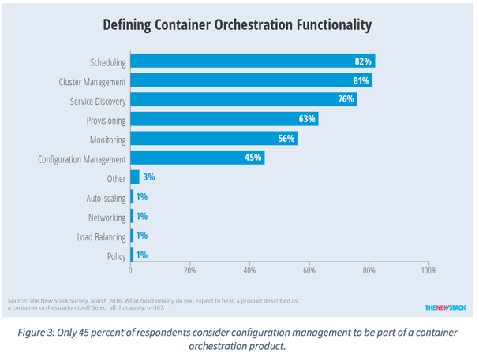
Container Orchestration Responsibilities
Container orchestration
Scheduling
Cluster management
Service discovery
Related functionality
Provisioning
Monitoring
Configuration management

Slide 44
Container Orchestration on Bluemix
In June 2015 when IBM Bluemix Container Service launched, open source orchestration projects were not available for production
Kubernetes – July 21, 2015
Docker Swarm – November 3, 2015
Apache Mesos – July 27, 2016
IBM developed custom orchestration to ensure anti co-location of containers within a group and container placement to the least utilized hosts
IBM Research runs rigorous performance and scalability testing (https://github.com/Open-I-Beam/containers-os) on various open source projects; then work with those communities to make improvements

Slide 45
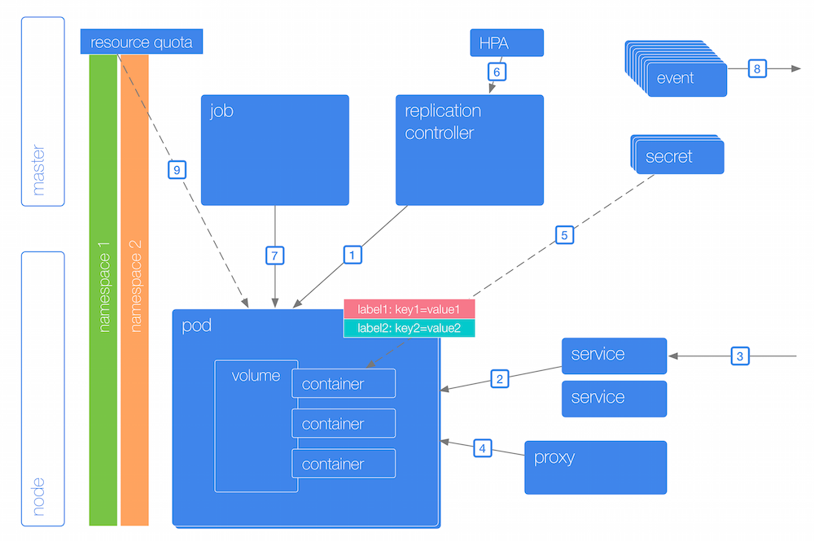
Kubernetes Terminology: Naming
Name
Namespace
Resource Quota
Label
Selector
ConfigMap
Secrets
Notes:
Name
Each resource object by type has a unique name
Namespace
Resource isolation: Each namespace is a virtual cluster within the physical cluster
Resource objects are scoped within namespaces
Low-level resources are not in namespaces: nodes, persistent volumes, and namespaces themselves
Names of resources need to be unique within a namespace, but not across namespaces
Resource quotas: Namespaces can divide cluster resources
Initial namespaces
default – The default namespace for objects with no other namespace
kube-system – The namespace for objects created by the Kubernetes system
Resource Quota
Limits resource consumption per namespace
Limit can be number of resource objects by type (pods, services, etc.)
Limit can be total amount of compute resources (CPU, memory, etc.)
Overcommit is allowed; contention is handled on a first-come, first-served basis
Label
Metadata assigned to Kubernetes resources (pods, services, etc.)
Key-value pairs for identification
Critical to Kubernetes as it relies on querying the cluster for resources that have certain labels
Selector
An expression that matches labels to identify related resources
ConfigMap
Configuration values to be used by containers in a pod
Stores configuration outside of the container image, making containers more reusable
Secrets
Sensitive info that containers need to read or consume
Encrypted in special volumes mounted automatically

Slide 46
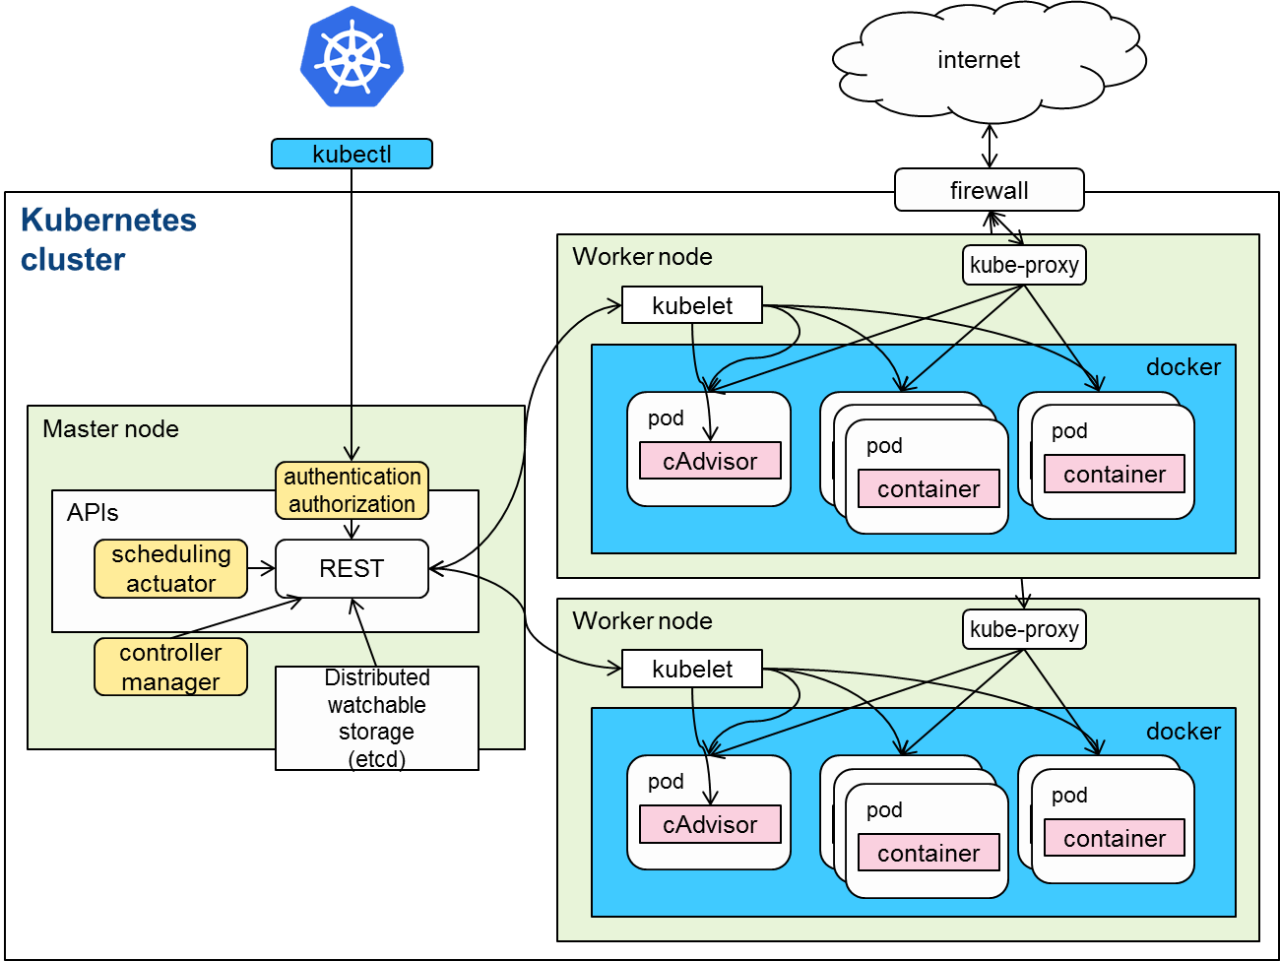
Kubernetes Architecture
Cluster
Master node
Worker node
Notes:
Cluster
Collection of worker nodes managed by the same master node
Makes the worker nodes behave like one big computer
Master node
Controls and manages the cluster
Scheduling and replication logic
Generally two or more master nodes for resiliency, but are not used for scaling out the cluster
Worker node
Node where pods are run
Docker – Docker engine for running containers (including the kubelet)
kubelet
Kubernetes agent that accepts commands from the master
Manages pods in the node
cAdvisor – Container Advisor provides resources usage and performance statistics
kube-proxy – network proxy service responsible for routing activities for inbound or ingress traffic

Slide 47
Kubernetes Terminology: Topology
Cluster
Collection of worker nodes managed by the same master node
Makes the worker nodes behave like one big computer
Master node
Controls and manages the cluster
Scheduling and replication logic
Generally two or more master nodes for resiliency, but are not used for scaling out the cluster
Worker node
Node where pods are run
Docker – Docker engine for running containers (including the kubelet)
kubelet
Kubernetes agent that accepts commands from the master
Manages pods in the node
cAdvisor – Container Advisor provides resources usage and performance statistics
kube-proxy – network proxy service responsible for routing activities for inbound or ingress traffic

Slide 48
Kubernetes Terminology: Master Node Components
Etcd
A highly-available key value store
All cluster data is stored here
API Server
Exposes API for managing Kubernetes
Used by kubectrl CLI
Controller manager
Daemon that runs controllers, which are the background threads that handle routine tasks in the cluster
Node Controller – Responsible for noticing and responding when nodes go down
Replication Controller – Replaced by ReplicaSet
Endpoints Controller – Populates the Endpoints object (that is, joins services and pods)
Service Account & Token Controllers – Create default accounts and API access tokens for new namespaces
Scheduler
Selects the worker node each pods runs in

Slide 49
Kubernetes Architecture: Workloads
Container
Unit of packaging
Pod
Smallest deployment unit in Kubernetes
A collection of containers that run on a worker node
Each pod has its own IP
A pod shares a PID namespace, network, and hostname
Service
Collection of pods exposed as an endpoint
Information stored in the Kubernetes cluster state and networking info propagated to all worker nodes
Types
ClusterIP – Exposes the service on a cluster-internal IP
NodePort – Exposes the service on each Node’s IP at a static port
LoadBalancer – Exposes the service externally using a cloud provider’s load balancer
ExternalName – Maps the service to an external name (such as foo.bar.example.com)

Slide 50
Kubernetes Terminology: Naming
Name
Namespace
Resource Quota
Label
Selector
ConfigMap
Secrets
Notes:
Name
Each resource object by type has a unique name
Namespace
Resource isolation: Each namespace is a virtual cluster within the physical cluster
Resource objects are scoped within namespaces
Low-level resources are not in namespaces: nodes, persistent volumes, and namespaces themselves
Names of resources need to be unique within a namespace, but not across namespaces
Resource quotas: Namespaces can divide cluster resources
Initial namespaces
default – The default namespace for objects with no other namespace
kube-system – The namespace for objects created by the Kubernetes system
Resource Quota
Limits resource consumption per namespace
Limit can be number of resource objects by type (pods, services, etc.)
Limit can be total amount of compute resources (CPU, memory, etc.)
Overcommit is allowed; contention is handled on a first-come, first-served basis
Label
Metadata assigned to Kubernetes resources (pods, services, etc.)
Key-value pairs for identification
Critical to Kubernetes as it relies on querying the cluster for resources that have certain labels
Selector
An expression that matches labels to identify related resources
ConfigMap
Configuration values to be used by containers in a pod
Stores configuration outside of the container image, making containers more reusable
Secrets
Sensitive info that containers need to read or consume
Encrypted in special volumes mounted automatically

